Slide 1
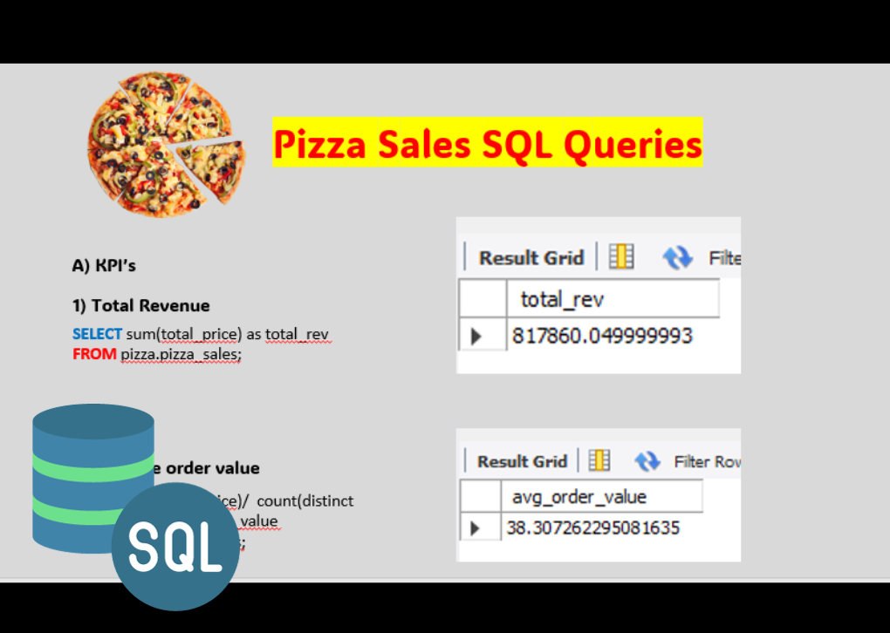

SQL QUERIES + PIZZA SALES POWER BI DASHBOARD

Slide 2
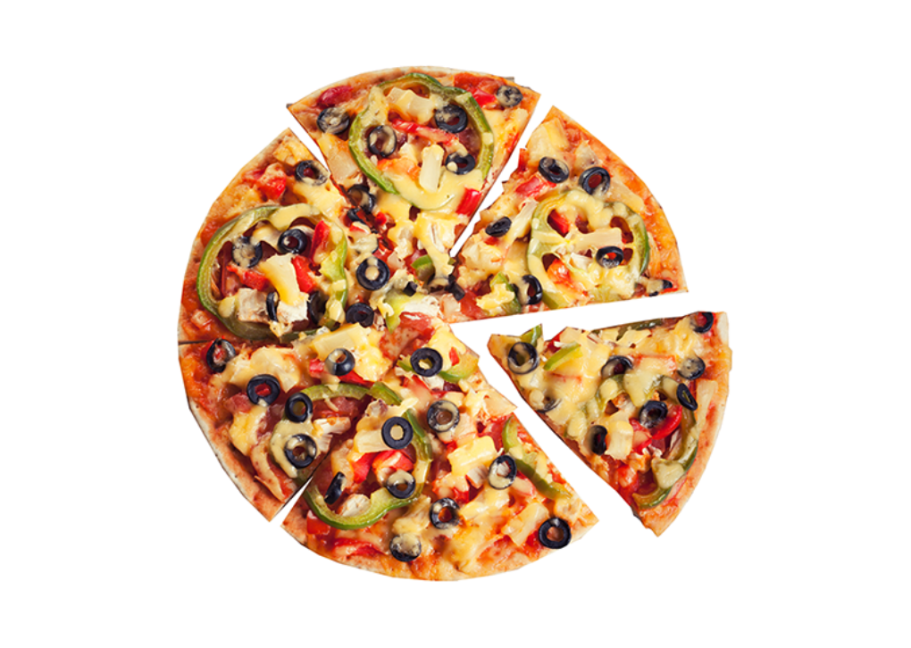


Pizza Sales SQL Queries
A) KPI’s
1) Total Revenue
SELECT sum(total_price) as total_rev
FROM pizza.pizza_sales;
2) Average order value
SELECT sum(total_price)/ count(distinct order_id) as avg_order_value
FROM pizza.pizza_sales;

Slide 3



3) Total pizza sold
SELECT sum(quantity) as total_pizza_sold
FROM pizza.pizza_sales;
4) Total orders
SELECT count(distinct order_id) as total_orders
FROM pizza.pizza_sales;
5) Average pizza per order
SELECT cast(sum(quantity) / count(distinct order_id) as decimal (10,2)) as avg_pizza_order
FROM pizza.pizza_sales;

Slide 4
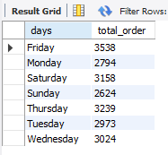
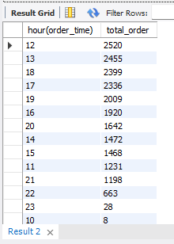
B) CHARTS REQUIREMENT
1) Converting date str to date (date)
SELECT str_to_date(‘01-01-2015’, ‘%d-%m-%Y’) as formatted_date
Update pizza_sales
SET order_date = STR_TO_DATE(order_date, ‘%d-%m-%Y’);
ALTER TABLE pizza_sales
Modify column order_date DATE
2) Daily trend for total orders
SELECT dayname(order_date) as days , count(distinct order_id) as total_order
FROM pizza.pizza_sales
GROUP BY dayname(order_date)
3) Hourly trend for total orders
SELECT hour(order_time) , count(distinct order_id) as total_order
FROM pizza.pizza_sales GROUP BY hour(order_time)

Slide 5
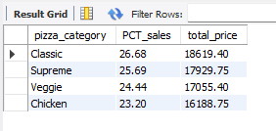
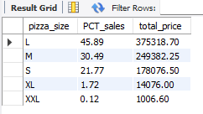
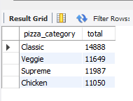
4) Percentage of sales by pizza category
SELECT pizza_category , cast((sum(total_price) * 100 / (select sum(total_price) from pizza_sales where month(order_date) = 1))as decimal(20,2)) as PCT_sales , cast(sum(total_price)as decimal (20,2)) as total_price
FROM pizza.pizza_sales where month(order_date) = 1
GROUP BY pizza_category
5) Percentage of sales by pizza size
SELECT pizza_size , cast((sum(total_price) * 100 / (select sum(total_price) from pizza_sales ))as decimal(20,2)) as PCT_sales , cast(sum(total_price)as decimal (20,2)) as total_price
FROM pizza.pizza_sales
GROUP BY pizza_size ;
6) Total pizza sold by pizza category
SELECT pizza_category , sum(quantity) as total
FROM pizza.pizza_sales
GROUP BY pizza_category;

Slide 6
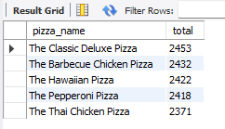
7) Top 5 best seller by total pizza sold
SELECT pizza_name , sum(quantity) as total
FROM pizza.pizza_sales
GROUP BY pizza_name
ORDER BY sum(quantity) desclimit 5
THANK YOU
- Bhumeet Solanky

